Slide 1
Basic Construction of an HTML Page:
Tables in HTML
How to create tables
Table attributes
Page lay-out using tables
Creating Html tables:
Tables display information in rows and columns. Tables are commonly used to display all manner of data that fits in a grid such as train schedules, television listings, financial reports etc.
<table> tag is used to start a table while </table> tag indicates the end of the table.
Table Structure
<tr> tag starts a row of the table and </tr> ends the row
<td> is used to create a cell inside the row while </td> ends the cell.
The contents of the cell are written between <td> and </td> tags
<th> tag is used to declare the cell of the heading row of the table

Slide 2
Basic Construction of an HTML Page:
Table attributes:
Table level attributes
Row level attributes
Cell level attributes
Table level attributes:
Row level attributes:
The Border Attribute: Indicates the presence of the border around the table: <table border=“1”>
The align Attribute: <table align= “center, right or left”>
The bgcolor Attribute: sets the background color
of the table: <table bgcolor=“gray”>
The background Attribute: sets the specified image at the background of the table: <table background=“image-title”>
The height and width Attributes:
The cellpadding Attribute: The cellpadding attribute is used to create a gap between the edges of a cell and its contents: <table cellpadding=“50”>
The valign Attributes:
<tr valign=“center,top or bottom”>
The align Attribute:
<tr align=“center,right or left”>
The bgcolor Attribute:
<tr bgcolor=“gray”>
The background Attribute:
<tr background=“image-name”>
The height and width Attributes:
<tr height=“20” widht=“20”>

Slide 3
Basic Construction of an HTML Page:
Cell level attributes:
The align Attribute:
<td align=“center,right or left”>
The bgcolor Attribute:
The height and width Attributes:
The valign Attributes:
a)The rowspan Attributes: used when a cell should span across more than one rows.
b)The colspan Attribute: used when a cell should span across more than one column
Adding caption to the table:
<caption> tag is used to add a caption of the table
We usually add caption before the first row of the table

Slide 4
Basic Construction of an HTML Page:
HTML FORMS
Forms provide a means of submitting information from the client to the server
HTML supports tags for creating forms, however, it does not process the information
Use server-side script to process form information
Server-side script runs on the Web server and receives data from a form and uses it to perform a set of tasks
HTML FORMS elements
form> tag is used to start a form
</form> tag is used to end a form
Between <form> and </form>, form elements are placed
We can declare a form as: <form attributes>
form elements and layout tags: </form>
A single page can include several different forms, but you cannot nest one form inside another
Common Form Attributes:
  action - gives the URL of the application that is to receive and process the forms data
  method - sets the HTTP method that the browser uses to send the form's data to the server for processing; Either POST or GET
  name – name of the form

Slide 5
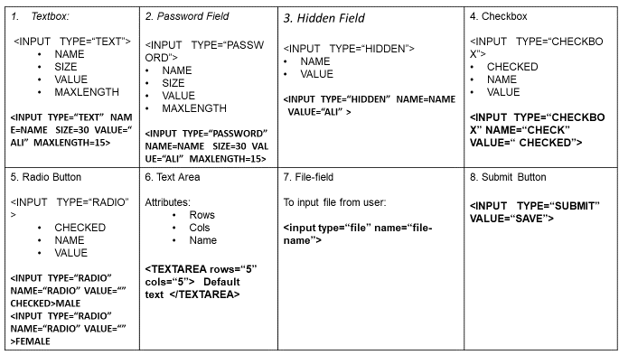
Basic Construction of an HTML Page:
HTML Forms and their elements

Slide 6
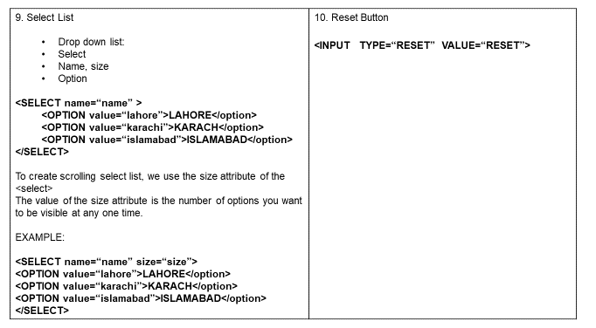
Basic Construction of an HTML Page:
HTML Forms and their elements

Slide 7
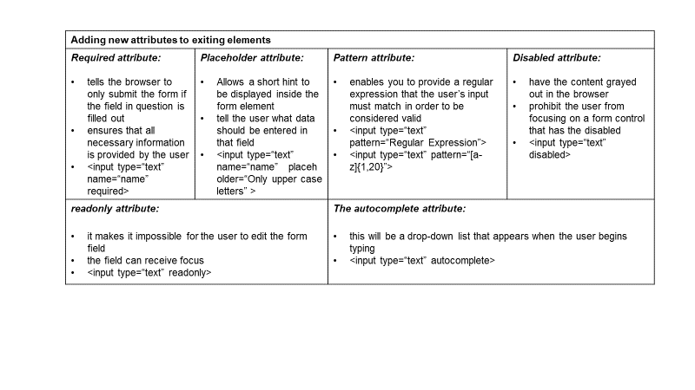
Basic Construction of an HTML Page:
Enhancements in forms
HTML5 enhances the forms in two ways

Slide 8
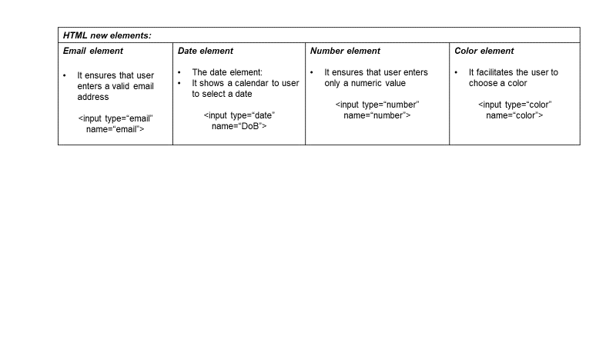
Basic Construction of an HTML Page:

Slide 9
Write accessible HTML using Semantic HTML tags
Semantic within HTML is the practice of giving content on the page meaning and structure by using the proper element. Semantic code describes the value of content on a page, regardless of the style or appearance of that content. There are several benefits to using semantic elements, including enabling computers, screen readers, search engines, and other devices to adequately read and understand the content on a web page. Additionally, semantic HTML is easier to manage and work with, as it shows clearly what each piece of content is about.
Before going into semantic elements, let’s look at two elements <div>s and <span>s that don’t hold any semantic value. They exist for styling purposes only. <div>s, and <span>s are HTML elements that act as containers solely for styling purposes.
To understand the difference between <div> and span<>, we must know the difference between inline and block elements
Block-level element: Block-level elements begin on a new line, stacking one on top of the other, and occupy any available width. Block-level elements may be nested inside one another and may wrap inline-level elements. We’ll most commonly see block-level elements used for larger pieces of content, such as paragraphs.
Inline-level elements: Inline-level elements do not begin on a new line. They fall into the normal flow of a document, lining up one after the other, and only maintain the width of their content. Inline-level elements may be nested inside one another; however, they cannot wrap block-level elements. We’ll usually see inline-level elements with smaller pieces of content, such as a few words.

Slide 10
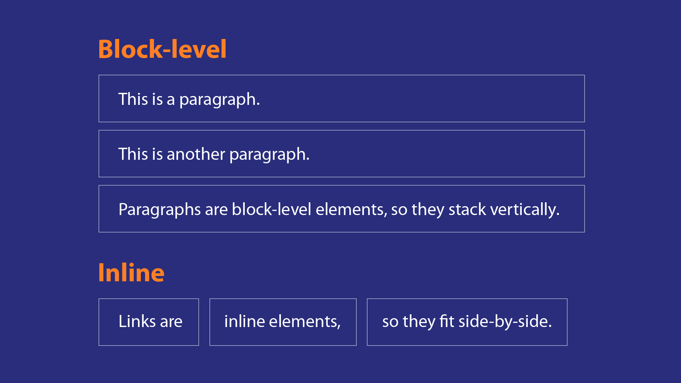
Write accessible HTML using Semantic HTML tags

Slide 11
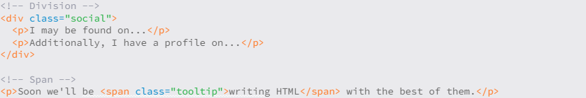
Basic Construction of an HTML Page:
A <div> is a block-level element that is commonly used to identify large groupings of content, and which helps to build a web page’s layout and design.
A <span>: It is an inline-level element commonly used to identify smaller groupings of text within a block-level element.
For example, if we have a <div> with an orange background that contains social media links, our first thought might be to give the <div> a class value of orange. What happens if that orange background is later changed to blue? Having a class value of orange no longer makes sense. A more sensible choice for a class value would be social, as it pertains to the contents of the <div>, not the style.

Slide 12
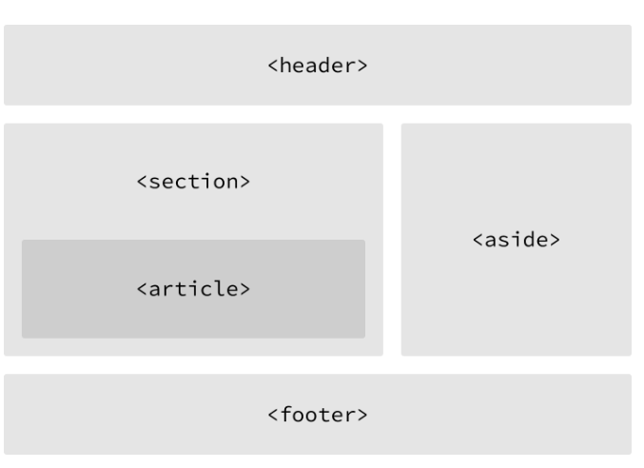
Write accessible HTML using Semantic HTML tags
Building Structure:
For the longest time the structure of a web page was built using divisions. The problem was that divisions provide no semantic value, and it was fairly difficult to determine the intention of these divisions.
Fortunately HTML5 introduced new structurally based elements, including the <header>, <nav>, <article>, <section>, <aside>, and <footer> elements. All of these new elements are intended to give meaning to the organization of our pages and improve our structural semantics.
They are all block-level elements and do not have any implied position or style. Additionally, all of these elements may be used multiple times per page, so long as each use reflects the proper semantic meaning.

Slide 13
Write accessible HTML using Semantic HTML tags
Building Structure:
Main: The main tag defines the primary section in the document related to the central content of a document with a <main> tag.
Section: It is used to define specific sections in a document such as a chapter, header, footer, or any other section, and is specified with the <section> tag.
Header: The header tag defines the title or heading of a document or its section. It is specified with the <header> tag.
Footer: The footer tag defines the section of a document that contains information such as copyright or author’s information. It is designated with the <footer> tag.
Article: The article tag represents an independent or self-contained part of the content of a document with the tag <article>.

Slide 14
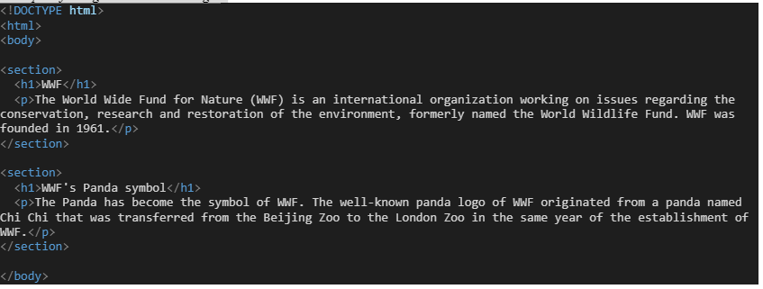
Example of using some semantic tags:
Making an html page using Semantics tags:
Open the notepad++ or VScode editor, and use some other semantic html tags on the above mentioned coding example: i.e. add <header>, <footer>, <aside> etc.

Slide 15
Questions ?

